Slide 1
FOR A BETTER WORLD…
TERTIARY ROADS
By,
Yogesh S Bellad
Yashswini D
Yogesh Babu S
Shreyas J Kumar

Slide 2




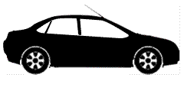
Traffic box[TBx]
Installed in every vehicle
Similar to setup box per TV
TBx
Locator
Memory
GPS
…
...
TBx
TBx
TBx

Slide 3
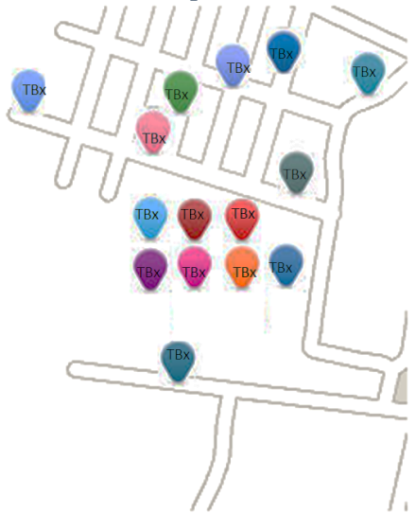
Advantages of TBx
Pin points location of every vehicle
Status of every vehicle learnt
Pings server on violation

Slide 4
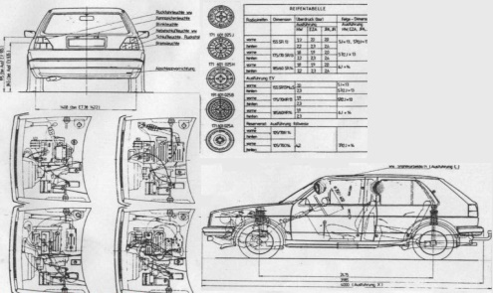


Advantages of installing TBx
Memory in every TBx stores-
Vehicle specifications
Registration Certificate
Driver’s details

Slide 5
Benefit to Authority
Reduction in -
1) Vehicle Identification Scams
2) Vehicle Theft Complaint
3) Need of multiple Policemen
Driver can be fined for breaking traffic rules easily
Instantaneous status of vehicle & history of vehicle
Improved vehicle surveying
TBx
Locator
Memory

Slide 6
Extensions (Pros for owner)
GPS Navigation System
AV Player + mobile phone integrator
Violation SMS alert
Avoid unnecessary fine as TBx can alert
(e.g.: No Parking area , 1 way ,Speed limit ,etc…)
Security :
1) License scanner which could be used as power key
2) Anti Theft

Slide 7
Surprise Facts
Data communication
-in unused lower generation Spectrum (2G)
Actually could eradicate concept of number plates
Bribing policemen also taken care
Simple procedure of installation & usage
Accidents are reduced
Driver can be alerted by emergency vehicle
Traffic Reduces & transport speed increases

Slide 8
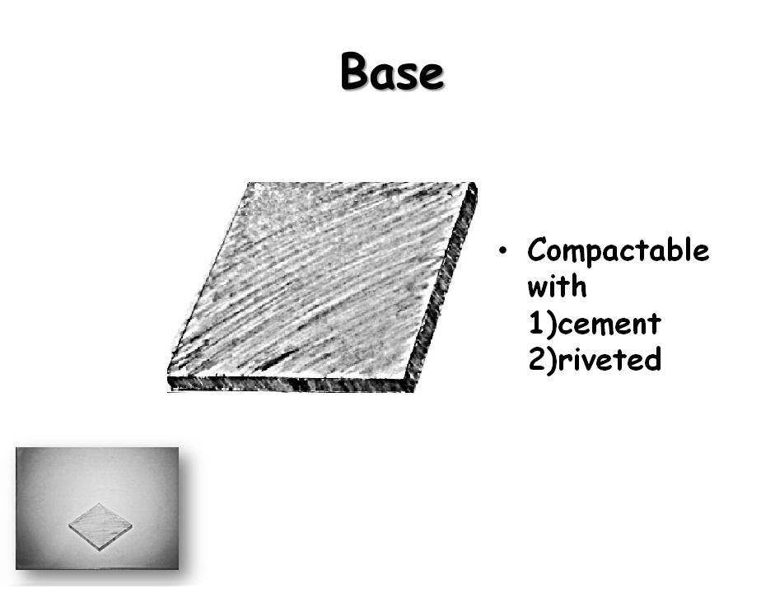

Base
Compactable with 1)cement 2)riveted

Slide 9

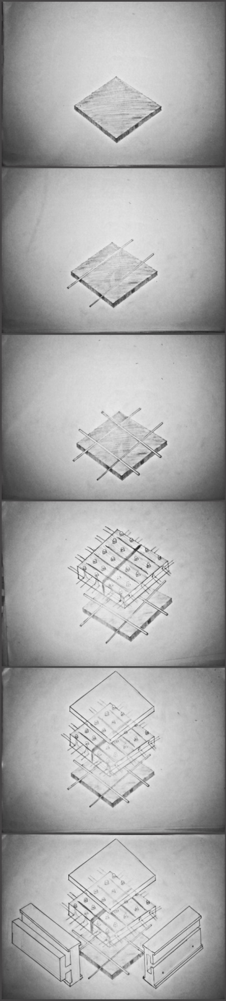
Interconnection
‘#’ connection
EVER-GRID

Slide 10
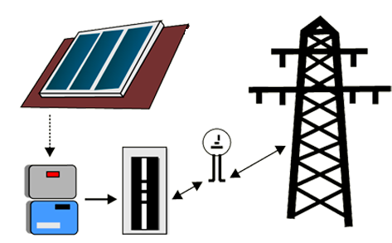

Solar cell
Extendable to existing grid

Slide 11
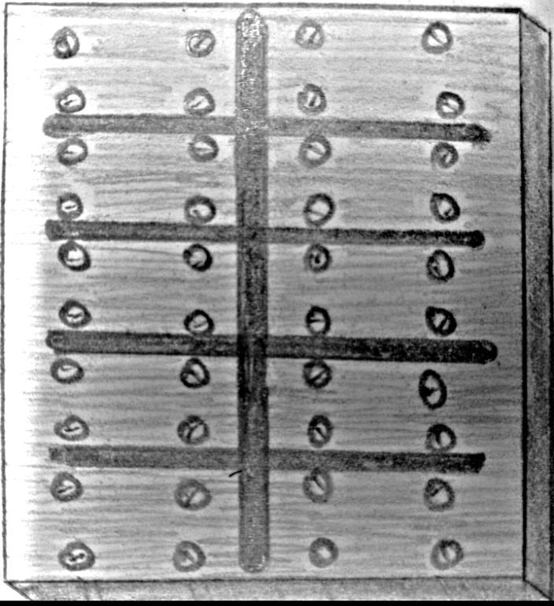

LED
Embedded in solar cells
Controlled via internet
For traffic signaling

Slide 12




Usage of LEDs
Emergency signaling
Traffic signals

Slide 13
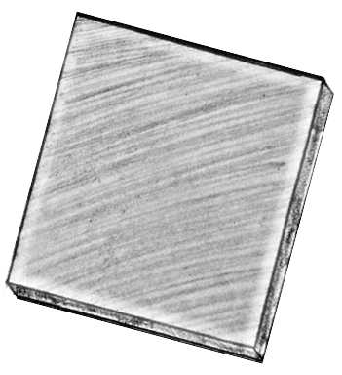

Polymer coating
LSR 7000 series
94% transparent
Silicone
High durability

Slide 14
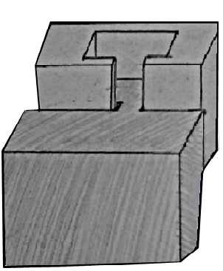

Interlocking frames
Provides connection and rigidity

Slide 15
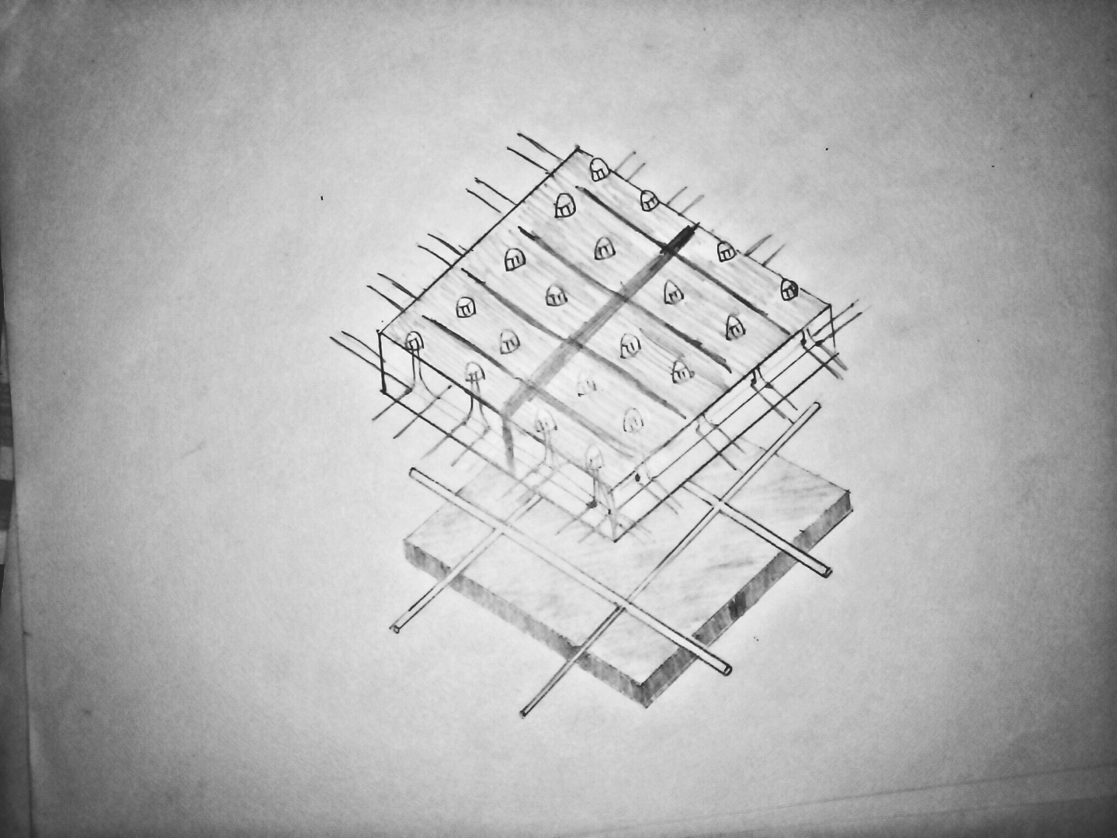

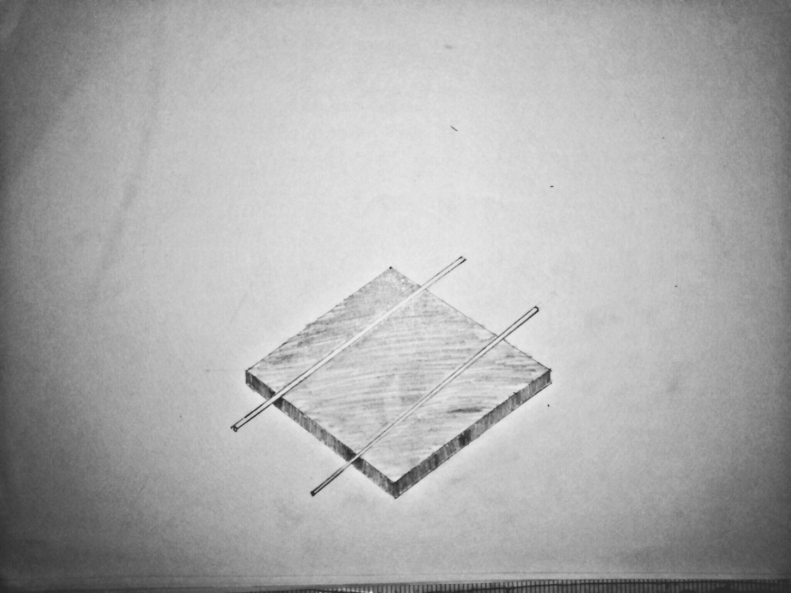
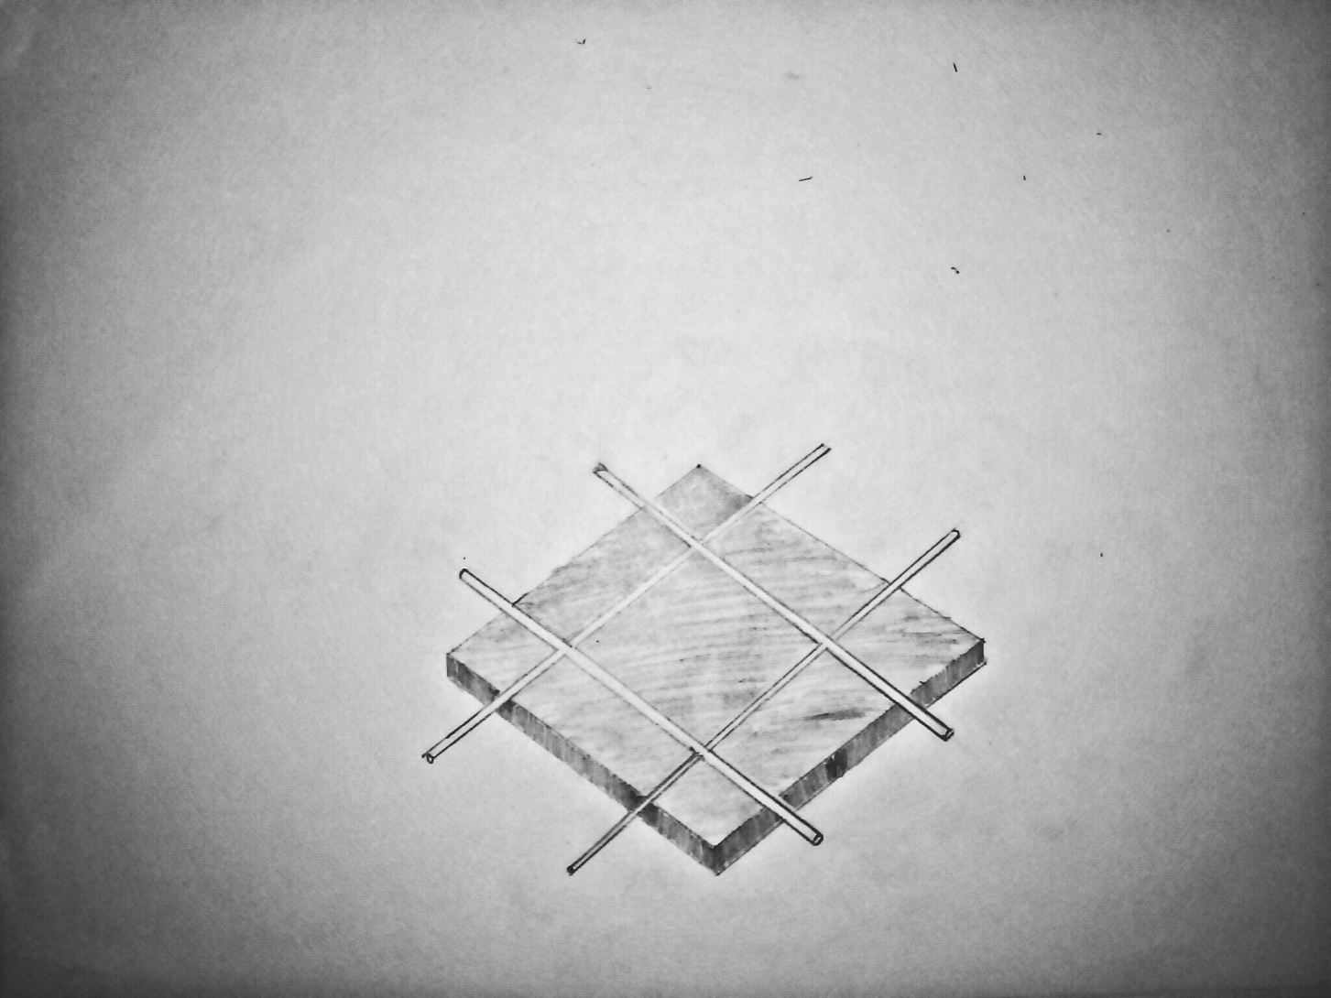
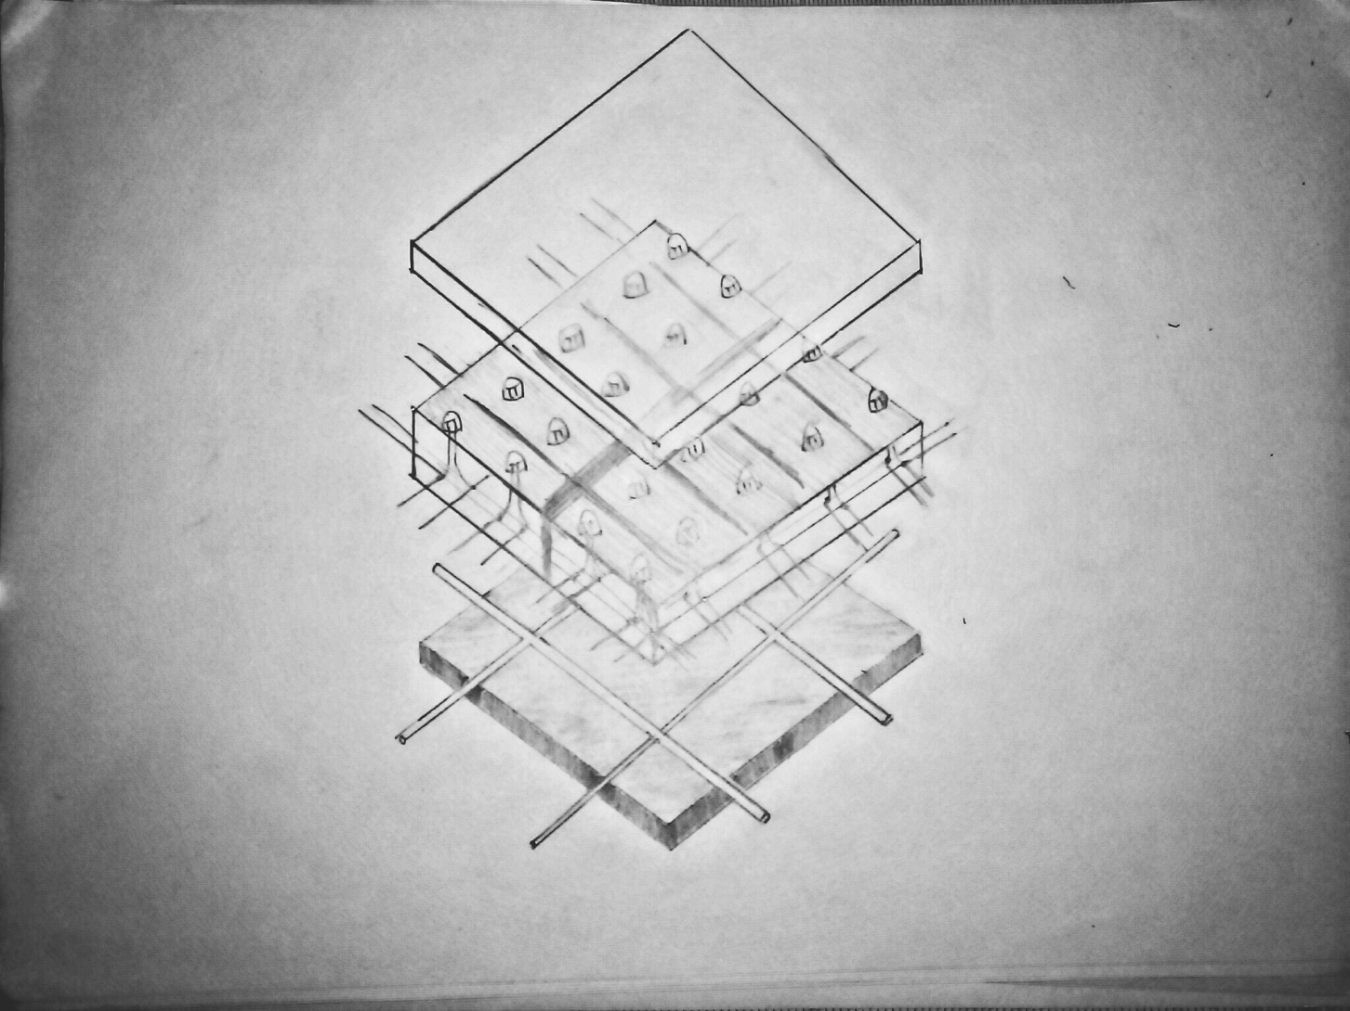
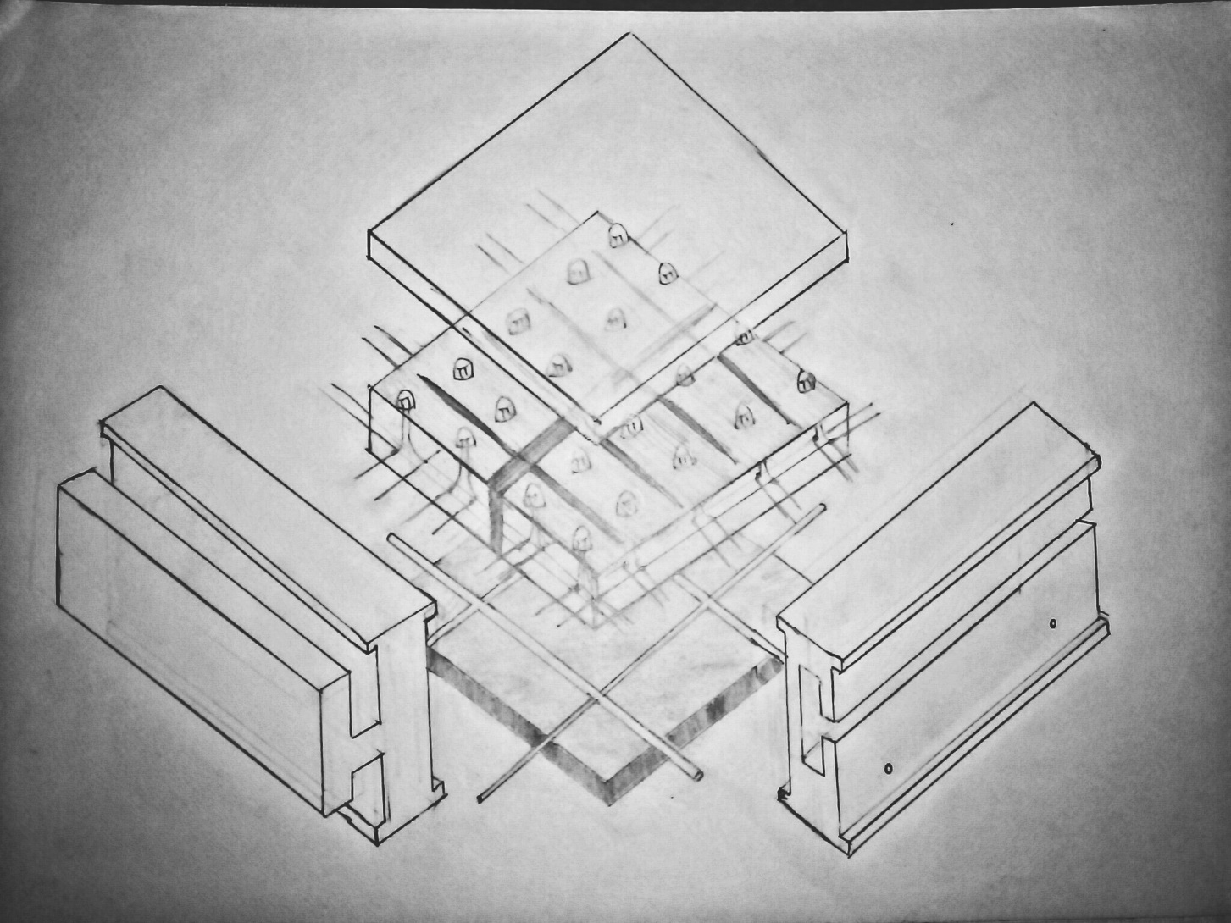
Final structure of the solar cell

Slide 16
THANK YOU…

